Slide 1
Systems Analysis, Behavior and Optimization Project
Peer Review Deliverable 1
Notes:
feedback from meeting: Figures were clear
Question 1 -
Question 2 Were there any other state variables the team considered? What was the next plan for question 2?
Create a table for variables used.

Slide 2
Problem 1
Reliability Analysis

Slide 3
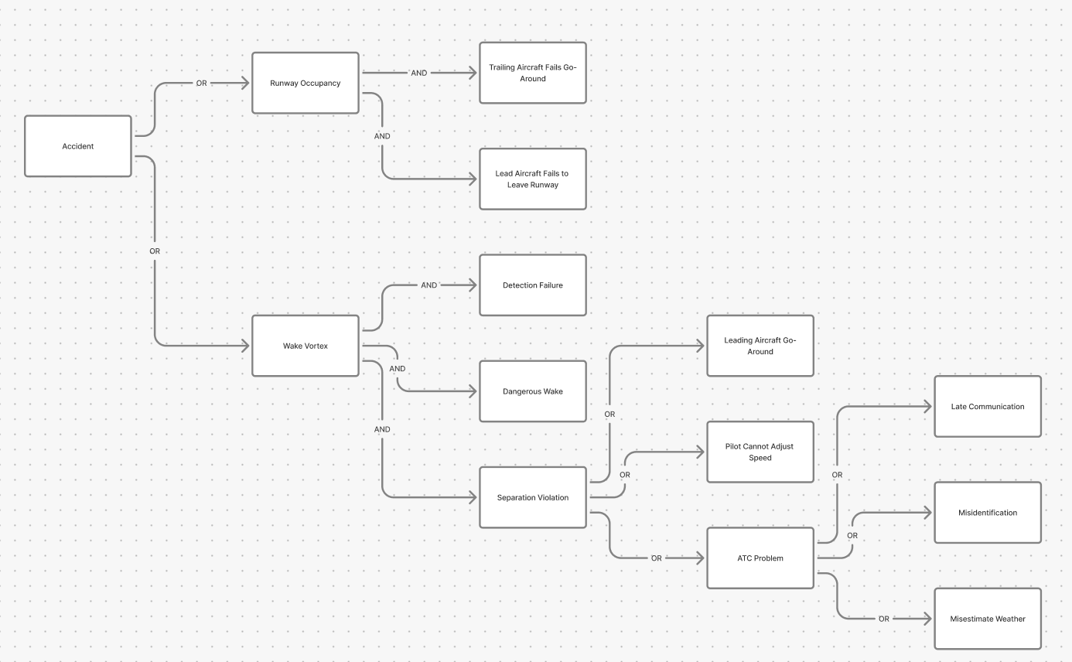
System Diagram

Slide 4
Trailing aircraft Fails GoAround
Leading Aircraft Fails to leave runway
Leading aircraft GoAround
Pilot Cannot adjust speed
Detection Failure
Dangerous Wake
Late Communication
Misidentification
Misestimate Weather

Slide 5
Plan to Proceed Pt.1
Reliability Analysis uses the systems diagram to define the structure function φ(x). Start by assigning a variable to each component in the system, then identify the state of the system based on how those components interact in the diagram. Once the structure is clear, the reliability can be interpreted through P(φ(x)=1) = E[φ(x)], which connects the system state to the probability that the system is functioning in the way being analyzed.
For the risk part, follow the diagram directly and translate each branch into probabilities. For the wake vortex branch, the events are connected by AND conditions, so the probability is built by multiplying the probability of a dangerous wake, the probability of separation violation, and the probability of detection failure. Inside the separation violation branch, the ATC part is an OR condition, so those probabilities are combined first before being used in the larger wake vortex calculation. The same idea applies to the other contributing paths in that branch.
The simultaneous runway occupancy branch is more straightforward. It is based on the probability that the lead aircraft fails to vacate the runway and the probability that the trailing aircraft cannot execute a go-around. After those pieces are found, multiply them to get the runway occupancy risk.

Slide 6
Plan to Proceed Pt 2
Once both branches are complete, the total accident risk can be approximated by adding the wake vortex probability and the simultaneous runway occupancy probability, since both events are rare and small. All calculations should be carried out separately for good weather and bad weather because several event probabilities depend on weather conditions.
For the wake vortex branch, first determine the probability that a dangerous wake exists using the aircraft size mix and the wake vortex table. Then evaluate the probability of separation violation by considering ATC problems such as misidentification, weather misestimation, and late communication, as well as trailing aircraft issues like the pilot being unable to adjust speed and communicate promptly, and lead aircraft go-around events. After that, combine the dangerous wake term, the separation violation term, and detection failure to obtain the wake vortex risk.
For simultaneous runway occupancy, use the lead-aircraft failure events and the trailing-aircraft failure events from the table, combine the events within each group according to the system diagram, and then multiply the two sides together to obtain the branch risk.
After the good-weather and bad-weather risks are found, combine them using the given weather proportions of 80% good weather and 20% bad weather. This gives the overall accident risk for Part 1.

Slide 7
Problem 2
Simulation of airport check-in and security lines

Slide 8
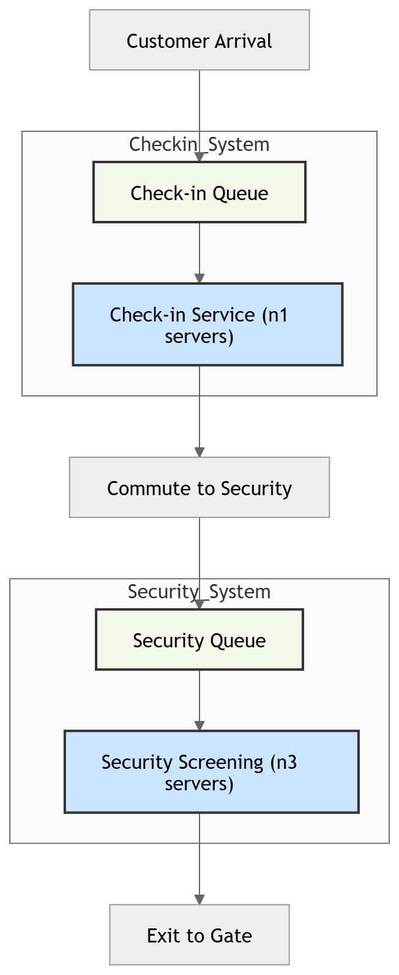
Customer Flow Diagram
S0 @ exp(10)
log(S1) @ N(0.1, 0.01)
S2 @ Positive(N(6, 1))
S3 @ exp(2)

Slide 9
State Variables
State variables at time t
Nq : Number of people in checkin system
Sq: Number of free servers for checkin system
Nc : Number of people in commute to security system
Ns: Number of people in security system
Ss : Number of free server in security system
These 5 variables can be used to completely describe initial system(with fixed n1 and n3)
Additionally, following variables required to measure performance across time horizon 3600 min (1day)
Narr: Number of people arrived in preboarding system
Ndep: Number of people departed from pre boarding system
o : System occupancy for given time, updated at each time step
Additional variables required for optimization
n1 : Number of servers in checkin system (Not required for this problem)
n3 : Number of servers in security system

Slide 10
Events
Event AC : Arrival at the checkin system
Event DC : Departure from checkin system
Event AS : Arrival at security system
Event DS : Departure from security system

Slide 11
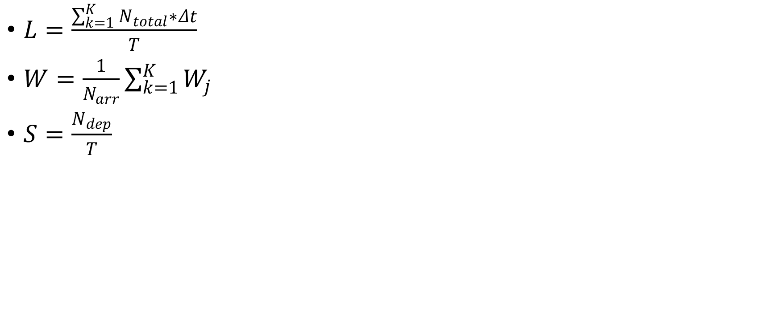
Performance calculation
-
Where,
L : Average number of people in system W: Average waiting time
S : Average number of people completed pre boarding

